Slide 1
Travel india

Slide 2
Website description
To make such experience easier to achieve, our focus has been how to help people travel better especially in India. If you are into adventure, we probably have one for you. If you are into culture, then you have come to the right place.
We would like to thank those who have been very resourceful to the including our genius our visitors. At Travel India, we are looking forward to providing more value-added services to travellers around the world. We hope you enjoy surfing as much as we do.

Slide 3
Link to where the website is hosted
https://github.com/tanvir2110/travelsite.git
http://tanvir21.pythonanywhere.com/

Slide 4
Contributions
Tanvir Husain: Made the signup form.
Darshana Upadhyay: Made the login form.
And linking the pages with the URL’s were done together over the phone.

Slide 5
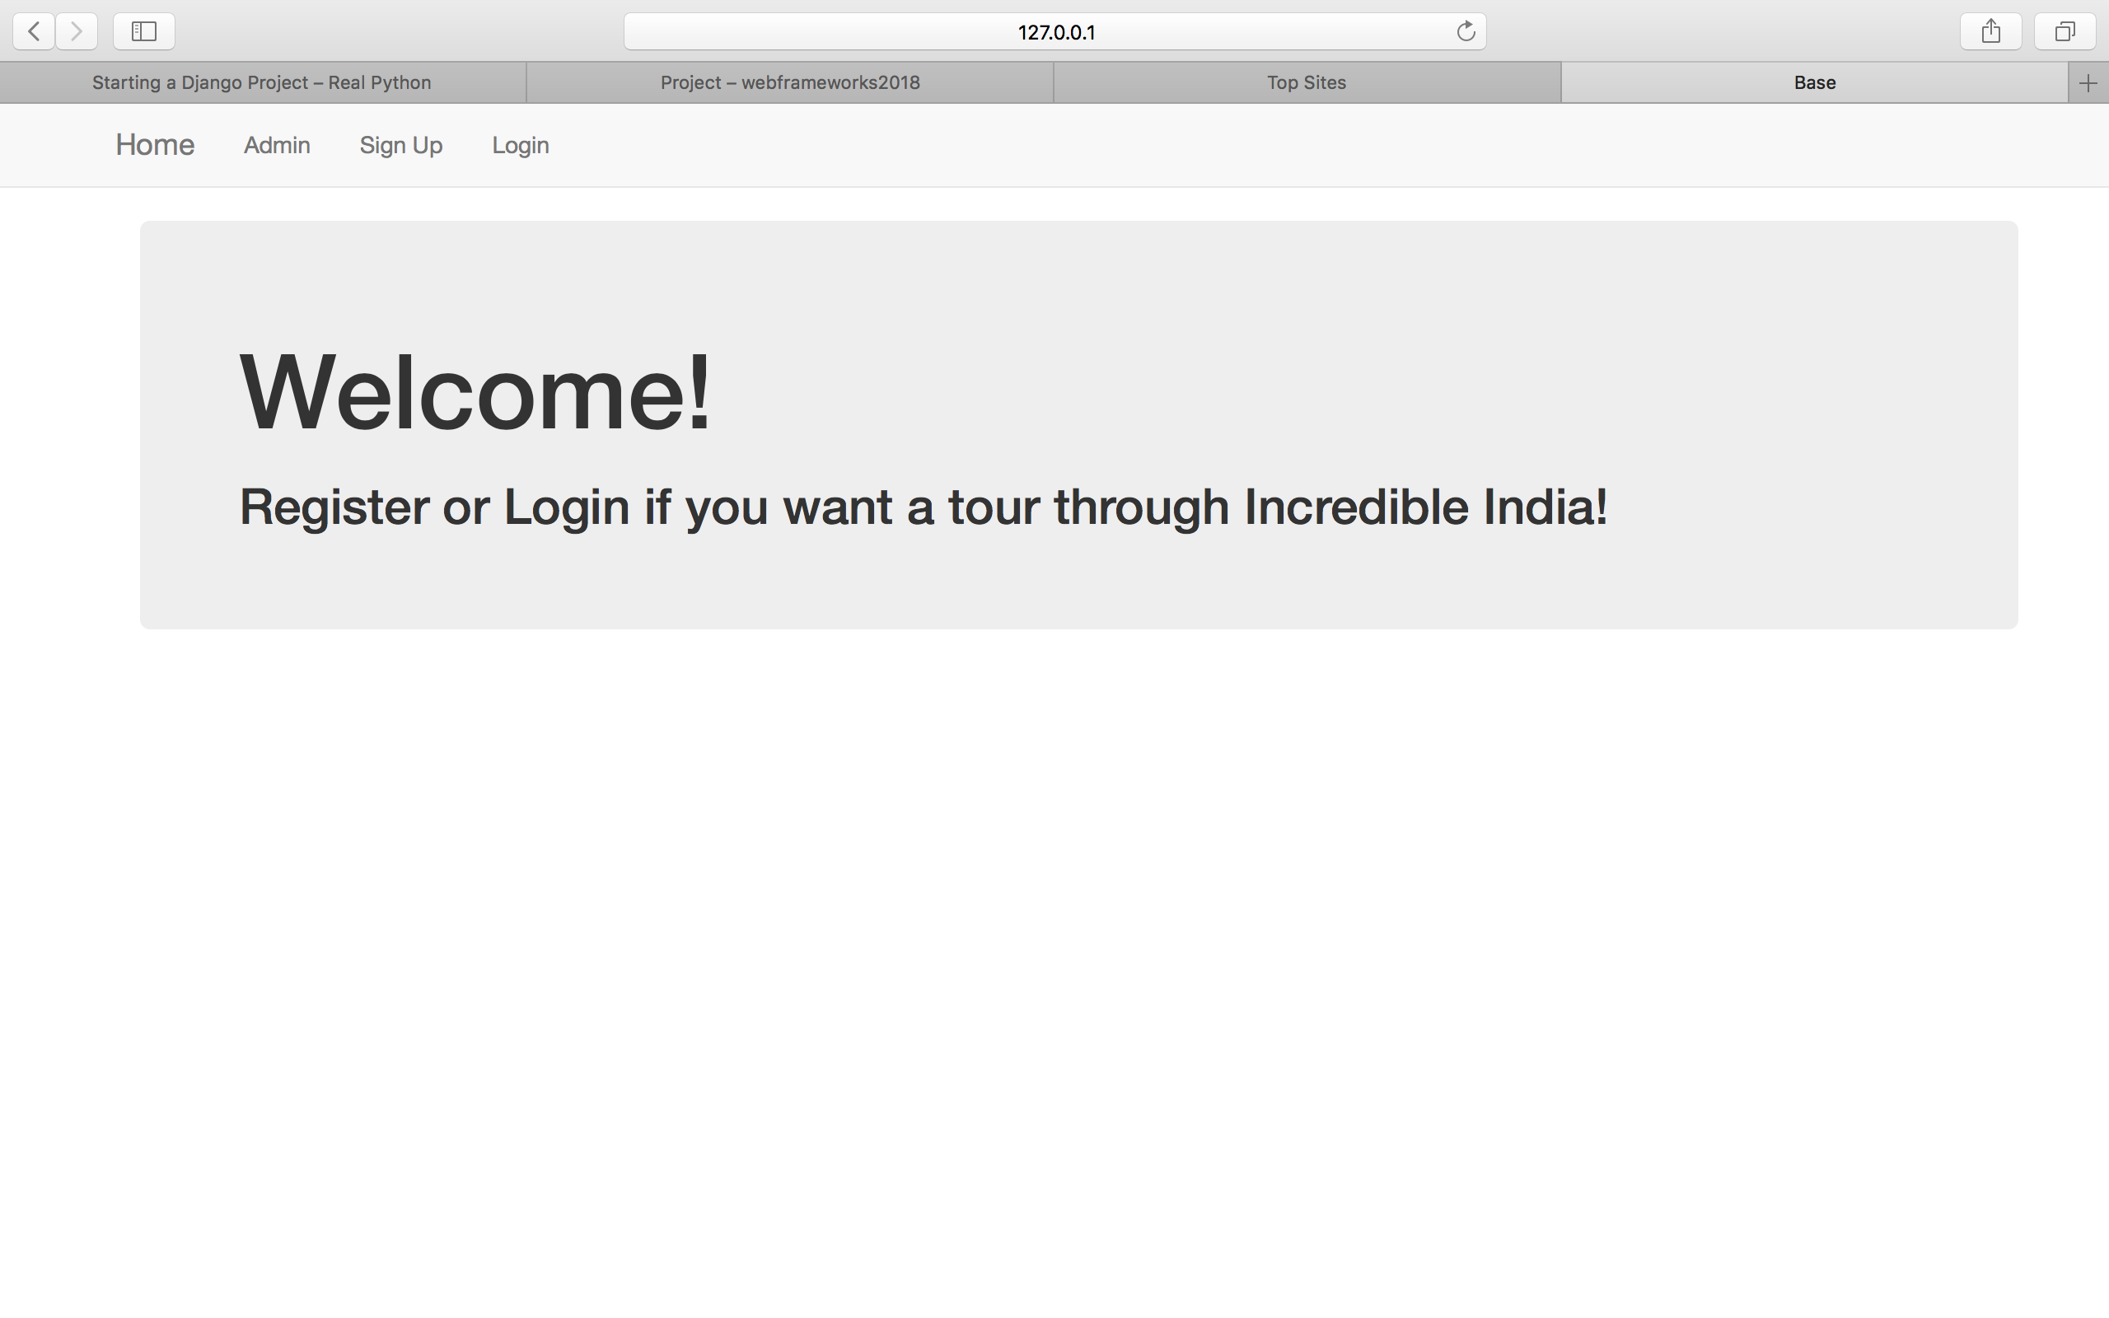

Slide 6
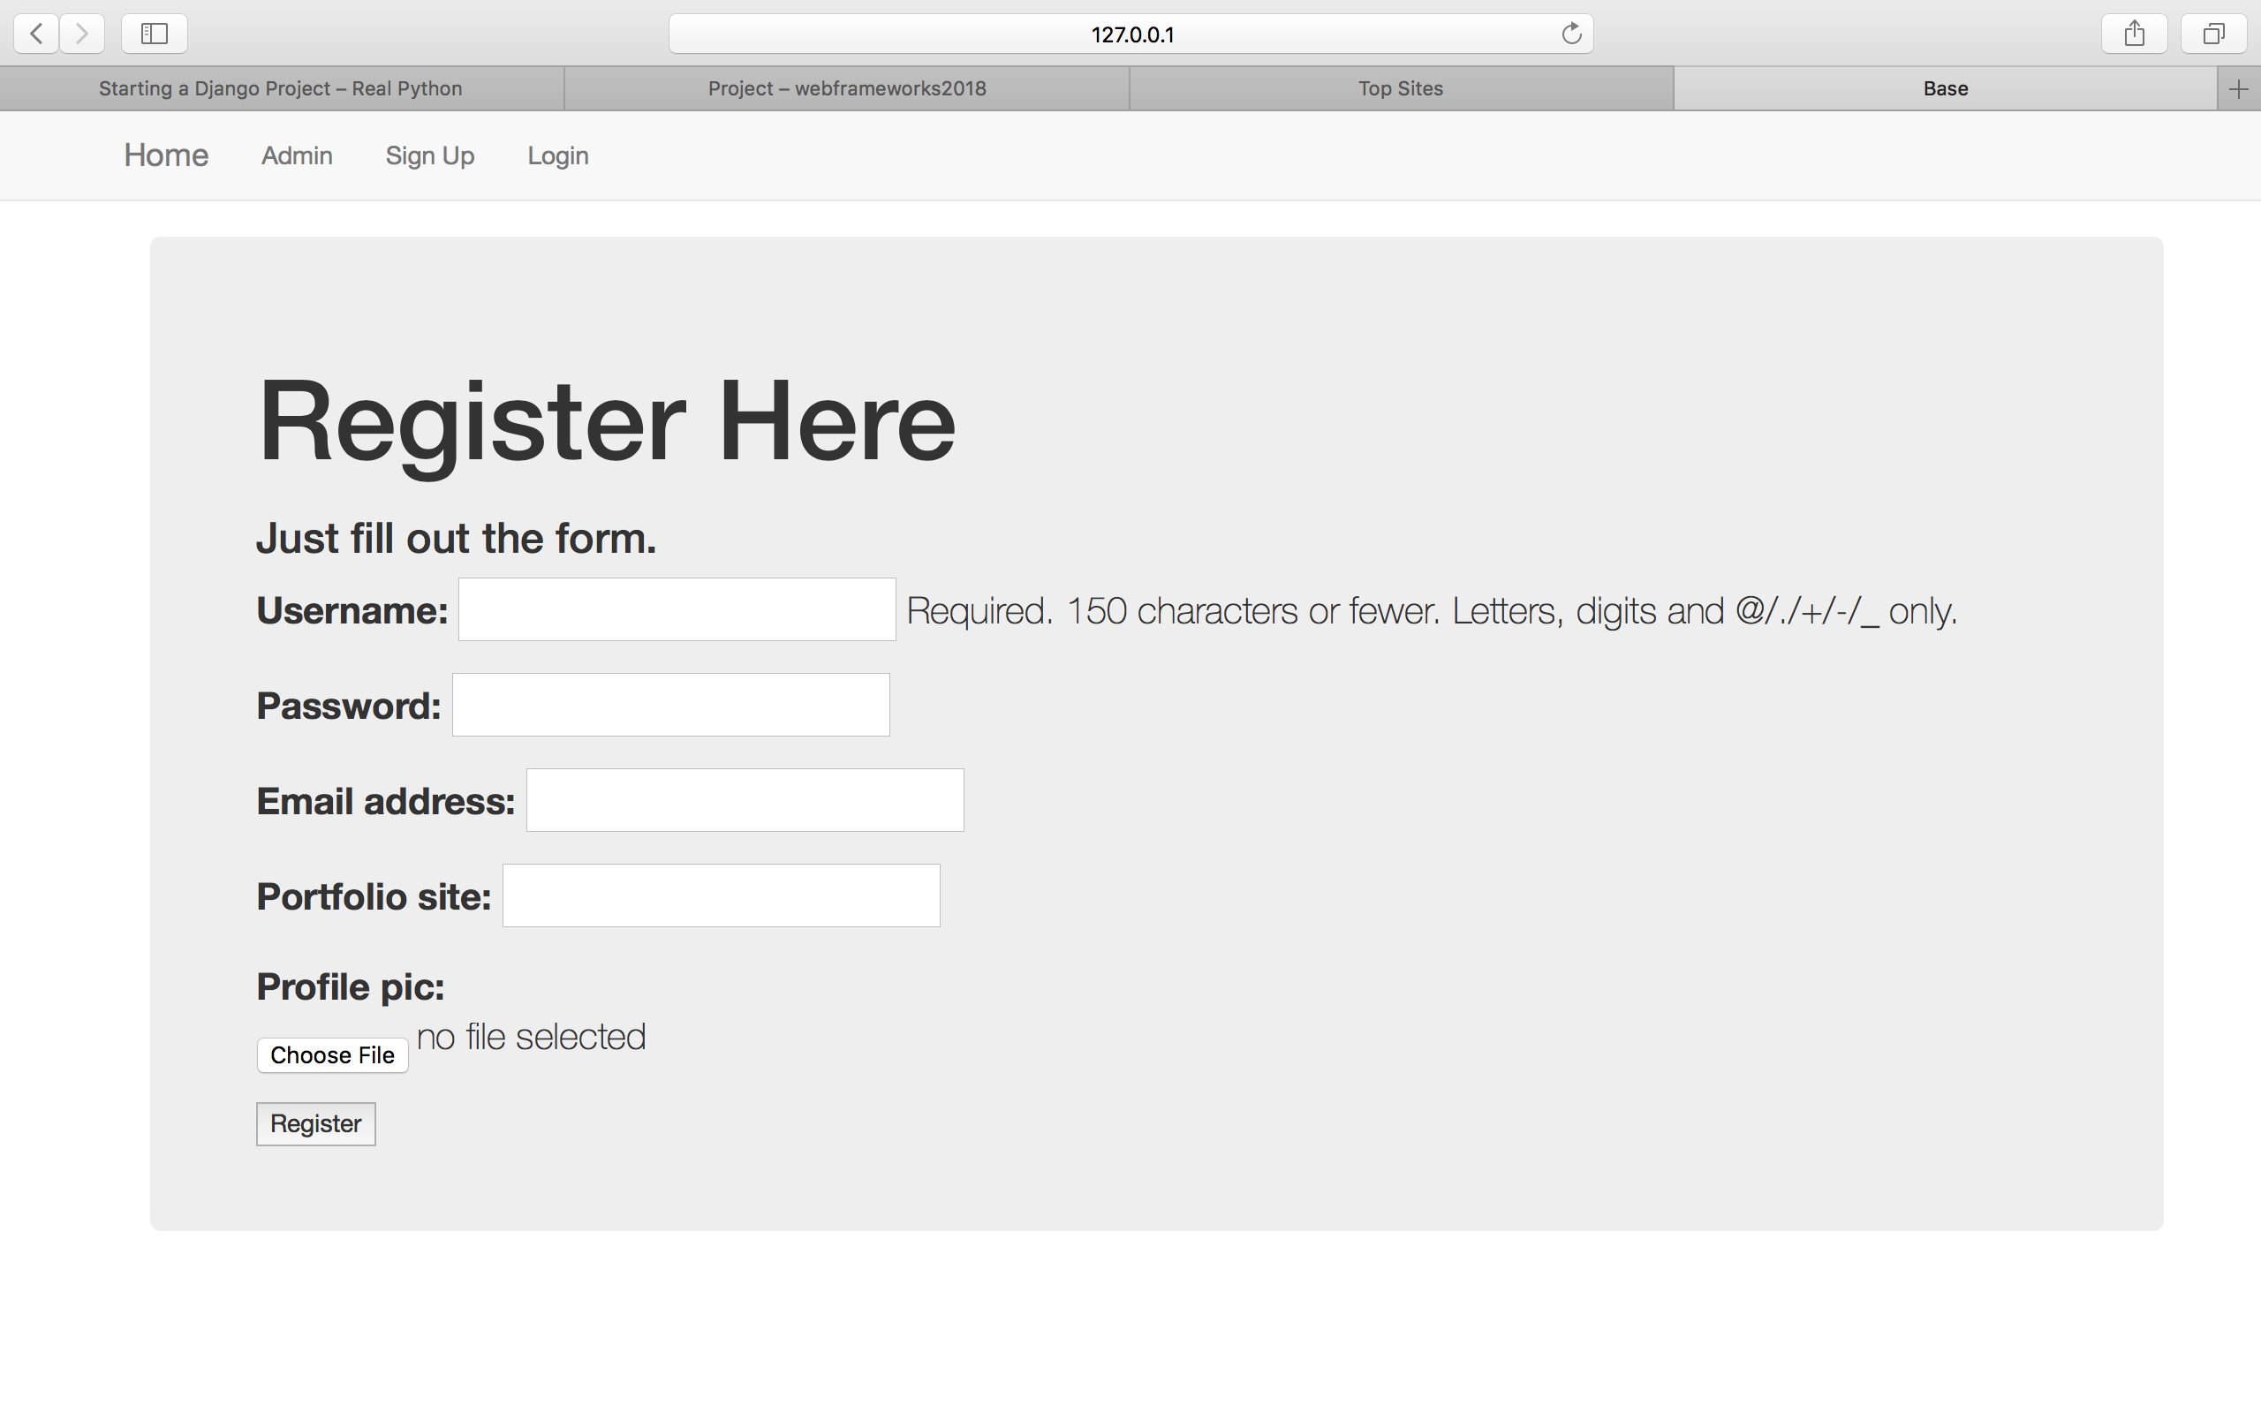

Slide 7
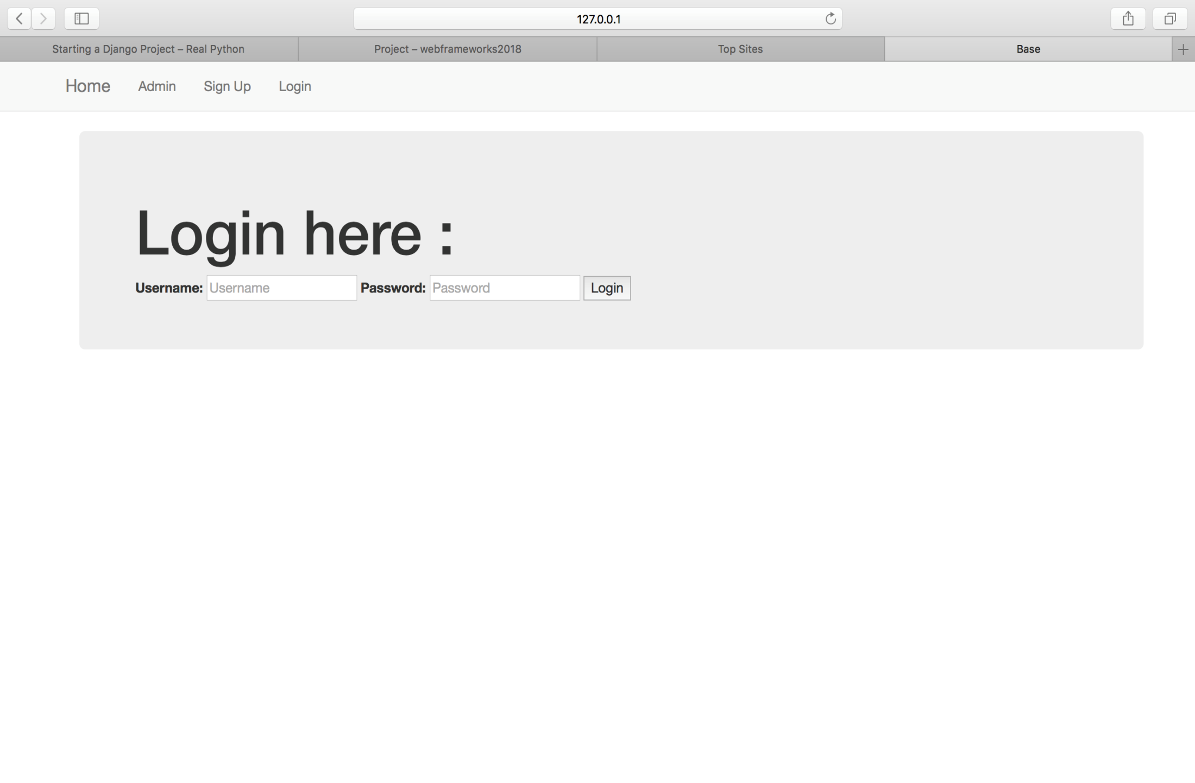

Slide 8
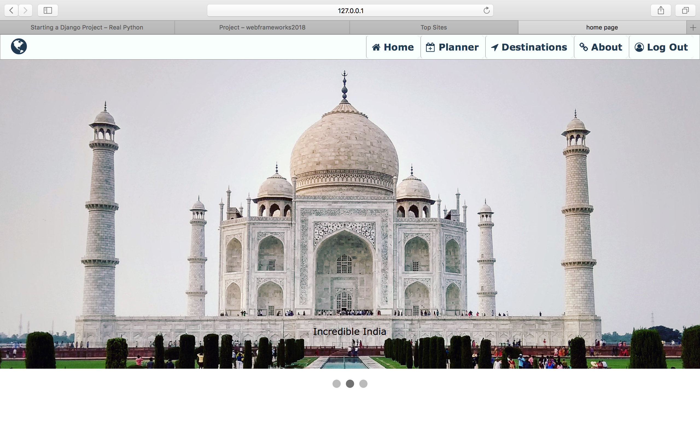

Slide 9
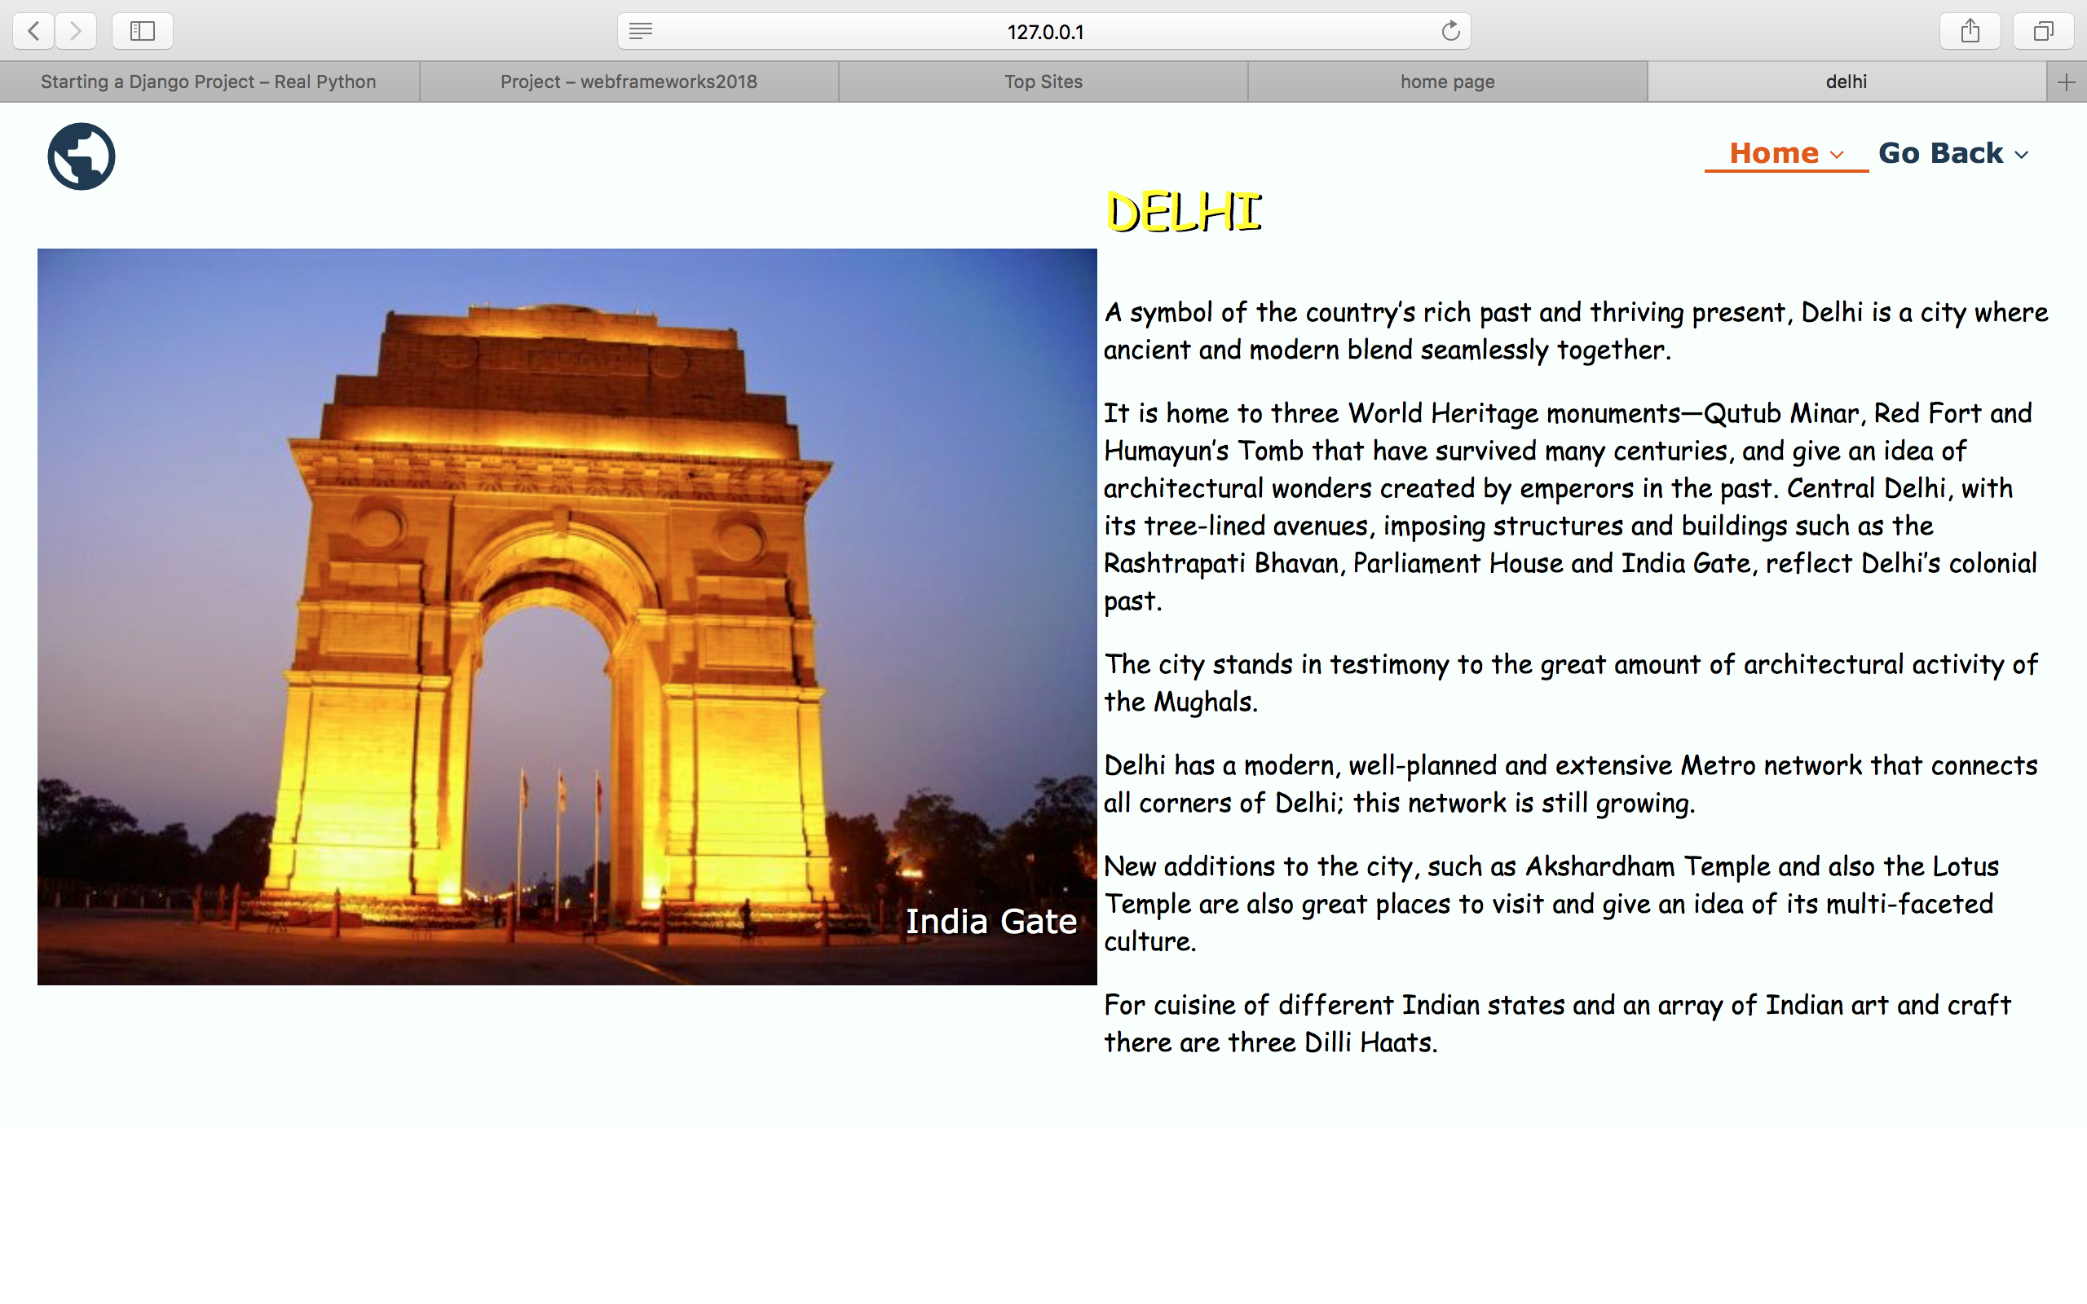

Slide 10
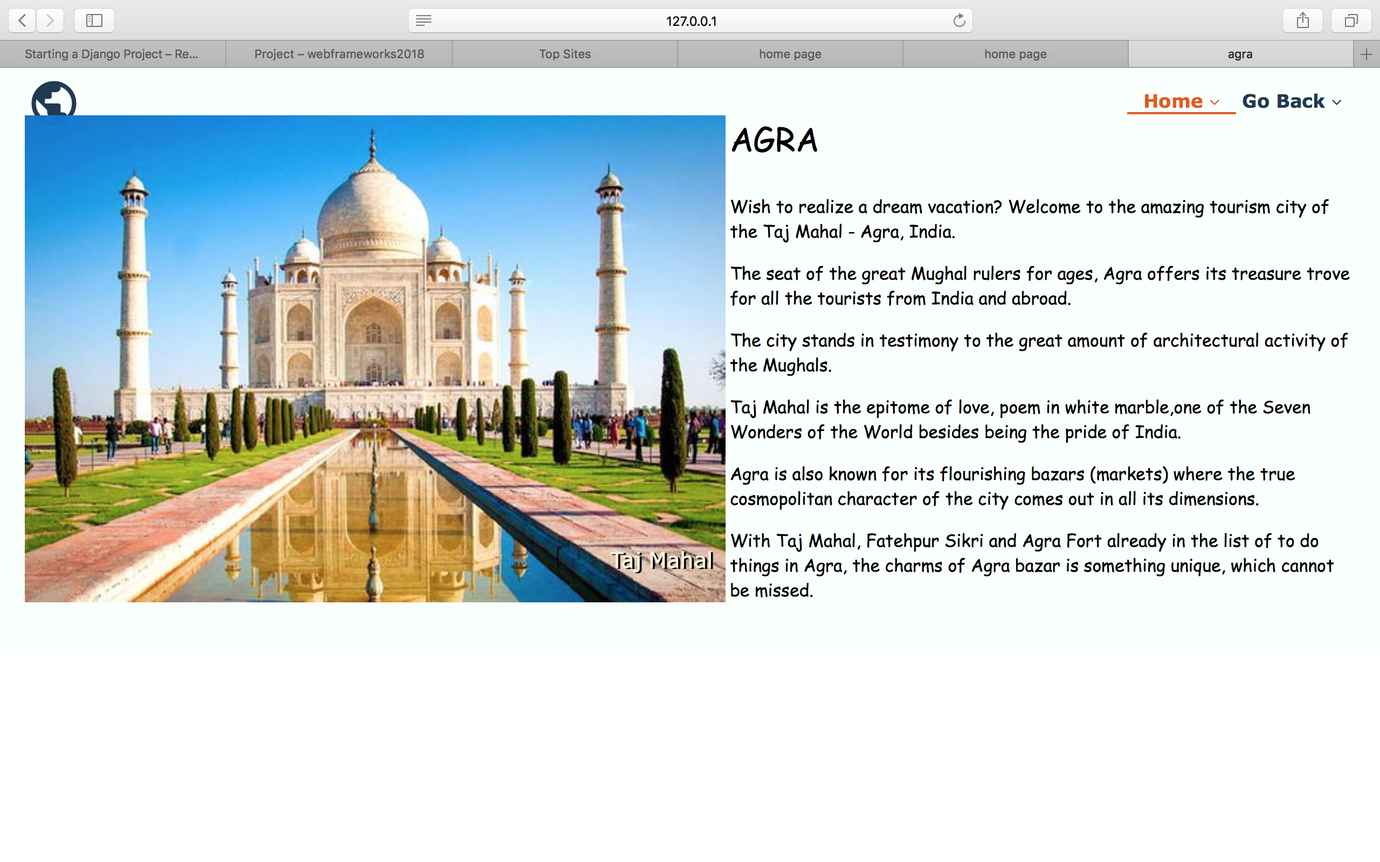

Slide 11
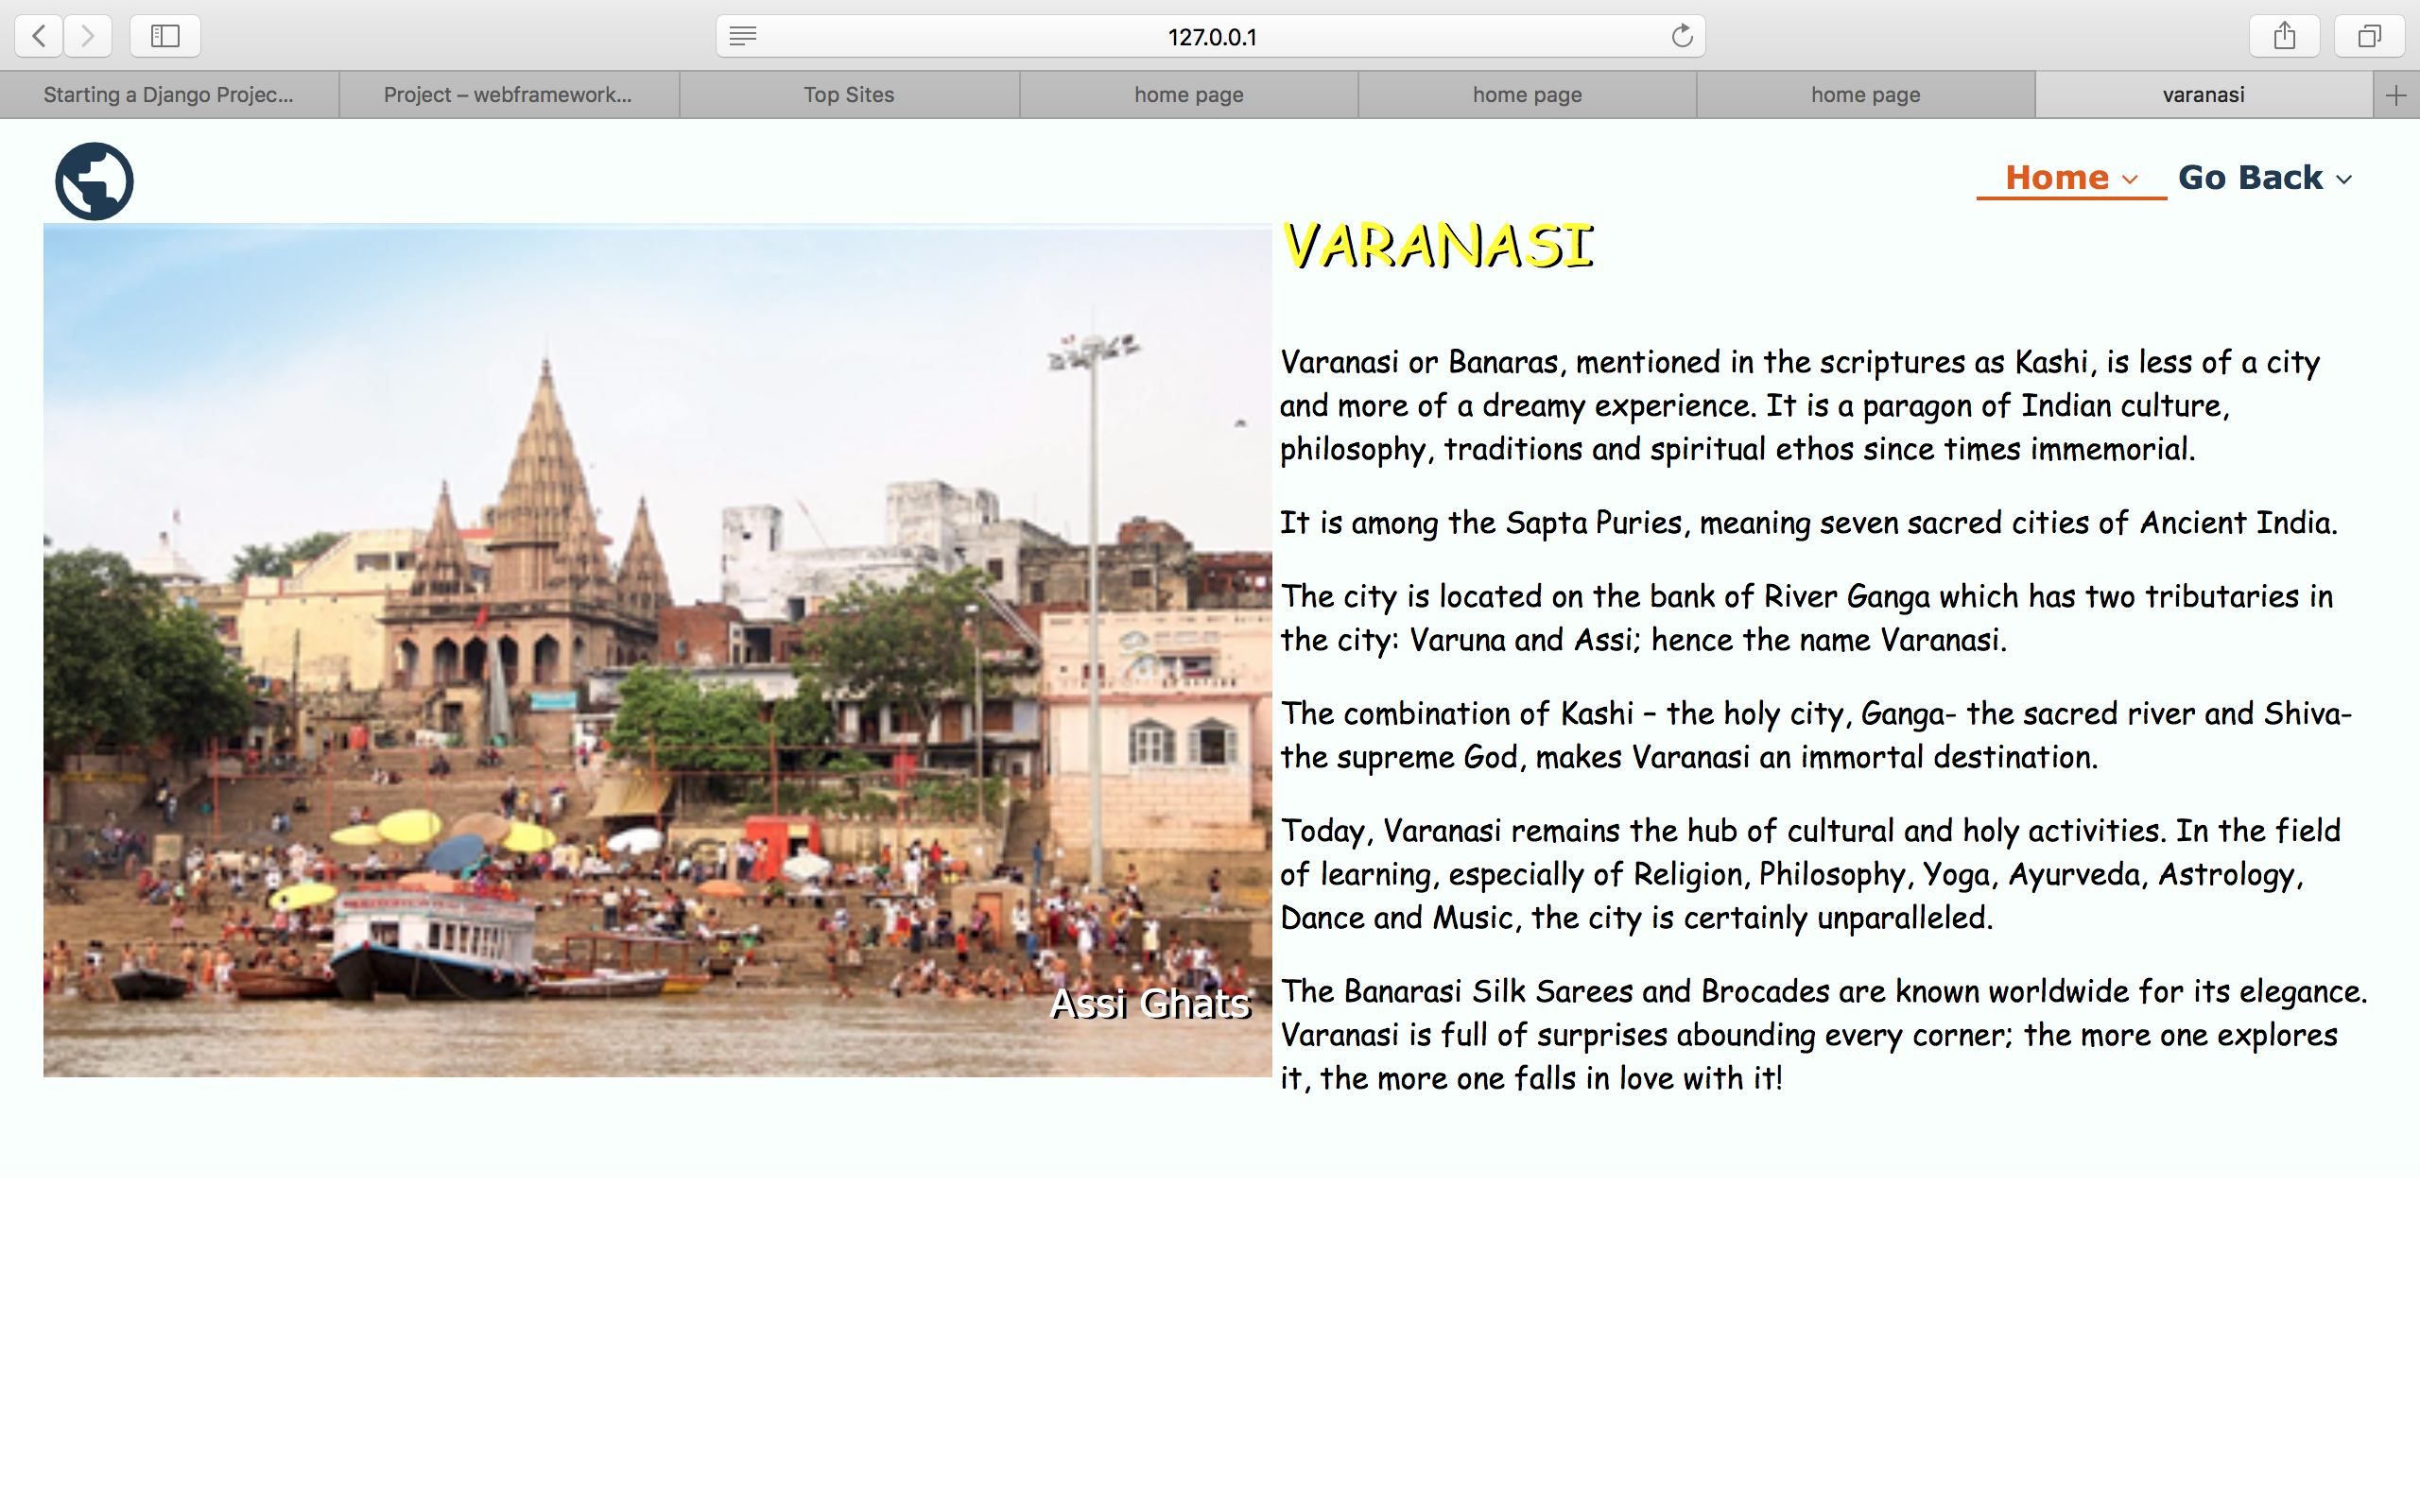

Slide 12
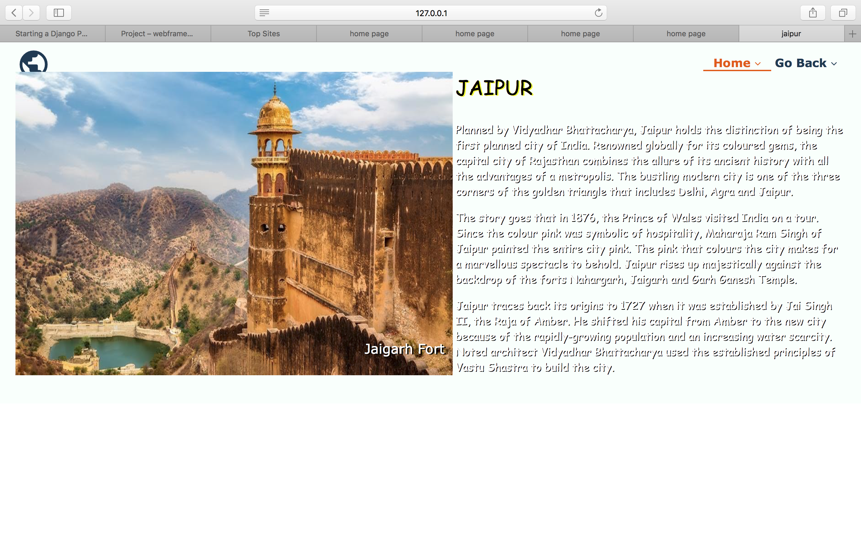

Slide 13
Takeaways
We learnt the following topics:
1.Models
2.URL dispatcher
3.Forms in Django
4.Working with templates
5.Migrations
6.Bootstrap
7. Writing views

Slide 14
Challenges
Making the signup form was challenging but we later worked it out using the guildelines mentioned in the django girls site.
Linking the forms with the html pages.

Slide 15
Contact info
Name: Darshana Upadhyay
USN: PES1201701615
Email-id: darshanaupadhyay.2015@gmail.com
Name: Tanvir Husain
USN: PES1201700090
Email-id: tanvirhusain99@gmail.com

Slide 16
Thank You!

